Slide 1


Slide 2
AIS Dynamic Defense Capture the Flag Exercise
Assured Information Security, Inc.

Slide 3
Disclaimer
All opinions, statements, or illustrations expressed either verbally, physically, or psychically are that of the author’s and do not represent that of our employer or our employer’s customers or partners.

Slide 4
Agenda
AIS R&D: Virtual Machine Introspection (VMI)
Hackathon Capture The Flag Challenges

Slide 5
Background: Virtual Machine Introspection
VMI is technology to observe or actuate events within guest virtual machines
Typically done without cooperation from the running virtual machine
Essentially provides ‘god-mode’ control over VMs and all from an architectural vantage point

Slide 6

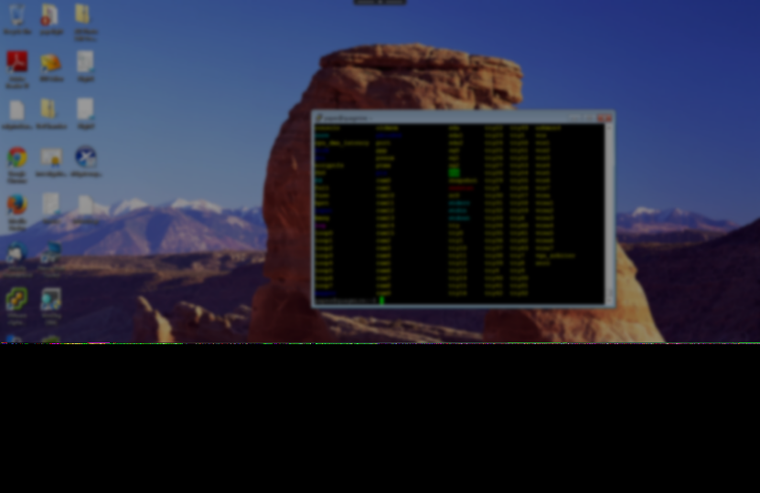
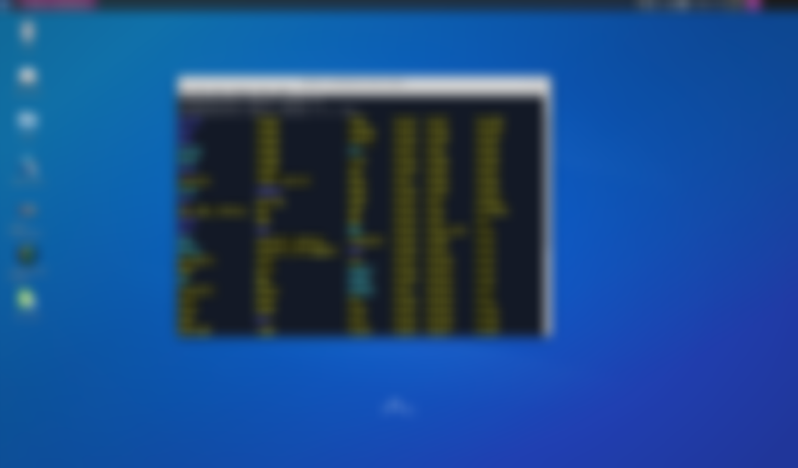


AIS’s IntroVirt Technology Overview
IntroVirt Introspection Toolstack
Target Guest Virtual Machines
Introspection Application Layer
Operating System Observation and Actuation
Windows®
Unix
Introspection Abstraction Layer
IntroVirt Hypervisor Hooks
Hypervisor
Hardware

Slide 7
Typical Uses of VMI
Defenses
Anti-Virus scans
Live guest patching
System Protection
Malware analysis
Software analysis
Reverse engineering

Slide 8
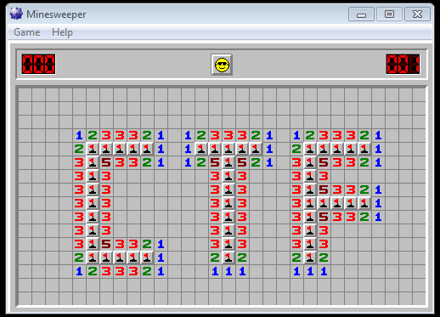

Slide 9
Changing gears….

Slide 10
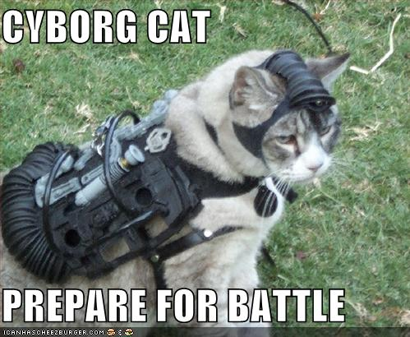
CTF Challenges Codename: “RUSTED BUNIONS”

Slide 11
We are INTENTIONALLY injecting INCONSISTENCIES into the RUSTED BUNIONs virtual machines
The actions you take will trigger changes in the system that may reveal the flag

Slide 12
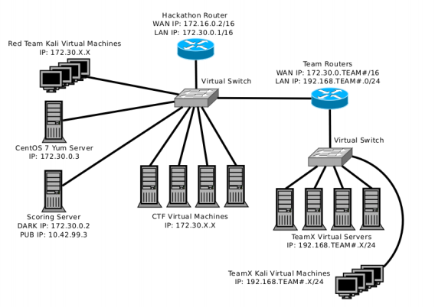
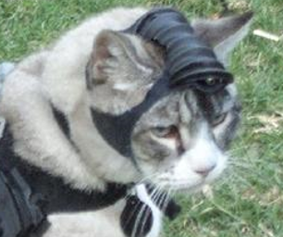
RUSTED
172.30.99.x
BUNIONS
YOU are here

Slide 13
CTF Challenge Overview
Multiple stages (VMs), each with a different flag
Non-linear, but may have dependent clues
Access vectors: RDP, existing backdoors, SSH, FTP
Tools: password crackers (hashcat), hexdump, netcat, rdesktop, and a lot of analytical skills
Observe: inconsistencies in filesystem, files you interact with, processes lists, or authentication.

Slide 14
Overview: RUSTED BUNIONS
Level 1: Easy
“Mouse Mayhem” 15 points
“Process Morpheus Jr. ” 25 points
“Process Morpheus Sr. ” 25 points
Level 2: Hard
“Definition of Insanity” 60 points
“Header Damage” 100 points
“Open Sesame” 85 points
“E.T. Phone Home” 85 points
Level 3: You wont get it job interview*
There is a domain controller, it’s locked down and has a flag.
*Must meet minimum qualifications, and see disclaimer slide

Slide 15
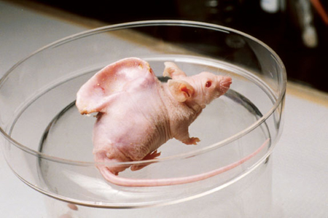
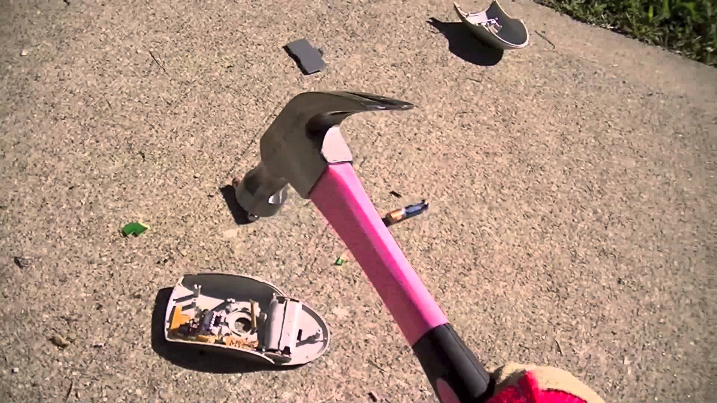
Easy: Mouse Mayhem (15 pts)
Good luck using the mouse
Hosts accessed via RDP and credentials you have cracked

Slide 16
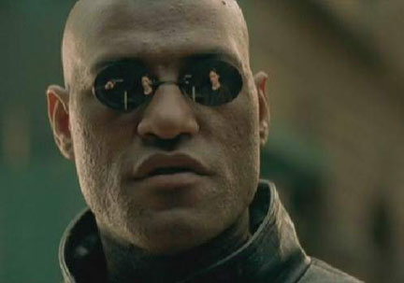


Easy: Process Morpheus Junior (25 pts) and Señor (25 pts)
Hosts accessed via RDP and cracked credentials

Slide 17
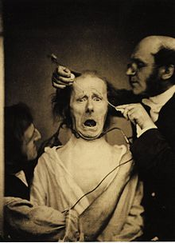

Hard: Definition of Insanity (60 pts)
Hosts accessed via SSH, and FTP

Slide 18
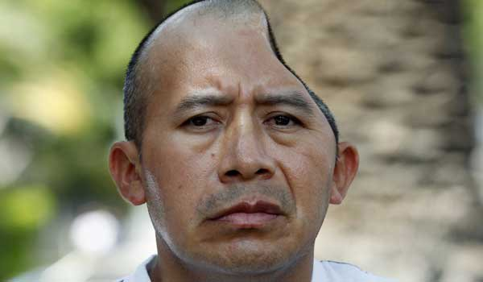
Hard: Header Damage (100 pts)
Access vectors: netcat and web interface
Copying the executables to the virtual machine results in corruption – do it right to evade the corrupter

Slide 19
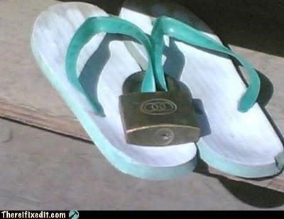
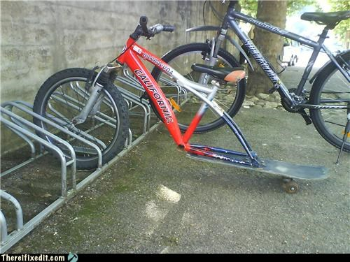

Hard: Open Sesame (85 pts)
Hosts accessed via brute forcing SSH credentials
….but, it can be brute forced by hand – you don’t need a super-hacker-uber tool
Once on the box, things get interesting

Slide 20

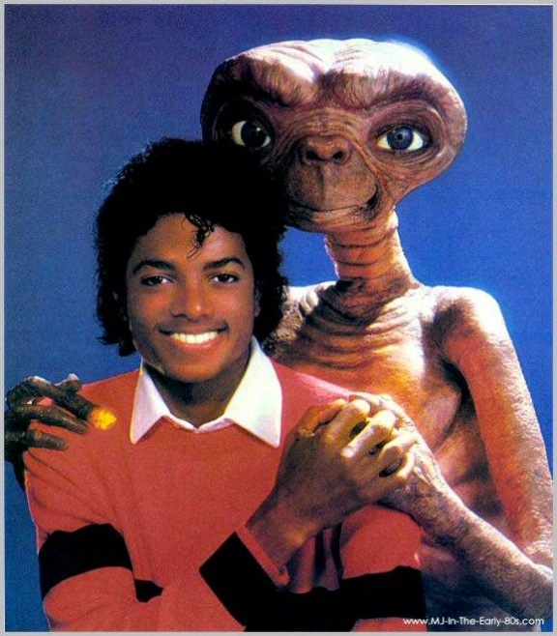
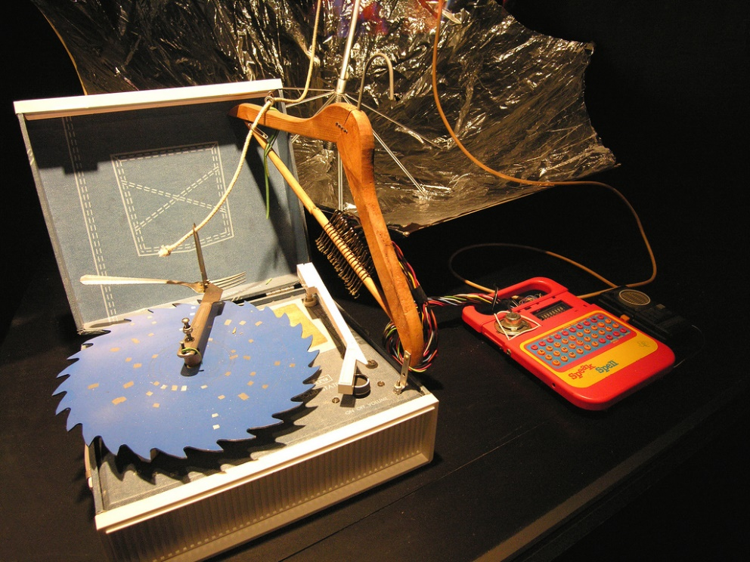
Hard: E.T. Phone Home (85 pts)
Maybe E.T. exploited a command execution bug in the Speak and Spell??
Once on the box, things get interesting

Slide 21
In Closing
The challenges are more about critical thinking and analytical skills than using crazy tools.
The basics will work.
Leaked credentials available at:
https://github.com/vix597/Ru5tedBun1ons

Slide 22
Thank You.
For more information visit us at ainfosec.com

